Slide 1

instructor’s notes
Insurance 101 for Teen Drivers
Notes:
Version 2: Updated 5-2016
**Instructors’ notes – THIS SLIDE NOT FOR CLASSROOM PRESENTATION
ABOUT THIS MODULE
Classroom presentation begins on slide 5.
Module assumes equal parts teacher presentation and student participation – goal to encourage students to point out what’s relevant to them (increase engagement).
Each slide includes the key message you want to deliver (see **), and Presentation Support, talking points and suggestions to use in the classroom as time permits.
BEFORE YOU START
Download and ENTIRE FOLDER, presentation + support materials.
Click through entire presentation in DISPLAY mode to familiarize yourself with animation, transitions and sound effects.
NOTE: If you save PowerPoint in a version older than 2003, sound effects will no longer play.
Print out slide w/Notes Pages for your reference.
Make color copies of Definitions, Game Worksheet, and Quiz.
Set computer volume to medium to high level to assure students can hear sound effects.
PRACTICE

Slide 2

Curriculum Objectives
Use simple language, interactivity and hands-on learning to teach auto insurance basics – definition of terms, how to buy, and keep costs down.
Goal: Help students get smart about insurance before something bad happens.
Notes:
**Instructors’ notes – THIS SLIDE NOT FOR CLASSROOM PRESENTATION

Slide 3
Materials
Animated PowerPoint ®
  Lecture: Insurance Basics (Terms)
  Get Smart Challenge (Request a Quote)
  It’s Your Choice (Interactive Game)
HANDOUT: Definitions of Terms
WORKSHEET: It’s Your Choice Game
QUIZ: Name That Coverage
Est. Time: 55 minutes + quiz
Notes:
**Instructors’ notes – THIS SLIDE NOT FOR CLASSROOM PRESENTATION

Slide 4
Instructions
Setup
  Review objectives, timing, format
Teach
  Walk through slides
  Handout definitions sheet
Play
  Explain game rules
  Handout tracking worksheet
Test
  Handout quiz, check for understanding
Notes:
**Instructors’ notes – THIS SLIDE NOT FOR CLASSROOM PRESENTATION

Slide 5
THE FACTS
Notes:
Classroom presentation begins here
**This is a financial education class; we are talking money today; but through a topic you may not have considered before.
Presentation Support
How many of you have your drivers’ license? (acknowledge % hands)
How many have your own car? (acknowledge % hands)
How many pay for your own car insurance (acknowledge hands, assumes lowest % of all three questions).
That’s what today is about. Because driving is the average teenager’s first adult responsibility, auto coverage is probably the first insurance decisions you make for yourself.
Let’s start with some basic facts.

Slide 6

Did you know …
26% of young people would rather clean a toilet than try to understand insurance benefits.
Notes:
**Or better yet, how about we start with a flush (CLICK)
Did you know 26% of young people would rather clean a toilet than try to understand insurance. This is a real statistic, from a Forbes Magazine survey.
Presentation Support
Trust me, I get it. Not the most exciting topic.
But financial literacy is about earning, saving and PROTECTING your money. That’s what insurance is for.
So hang with me for about 10 minutes for a few more facts. And some definitions of terms. Then I promise we’re going to have some fun.
Toilet flush courtesy of http://www.freesfx.co.uk

Slide 7
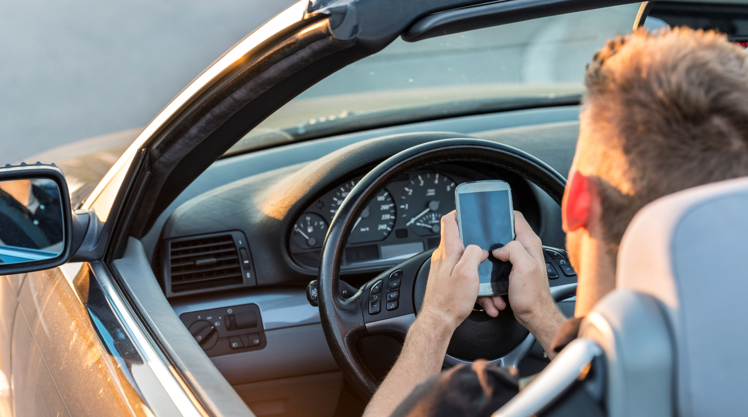
Did you know …
97% of teens say texting while driving is dangerous, but 43% admit to doing so anyway.
Notes:
**Read, pause for reaction/impact/commentary

Slide 8
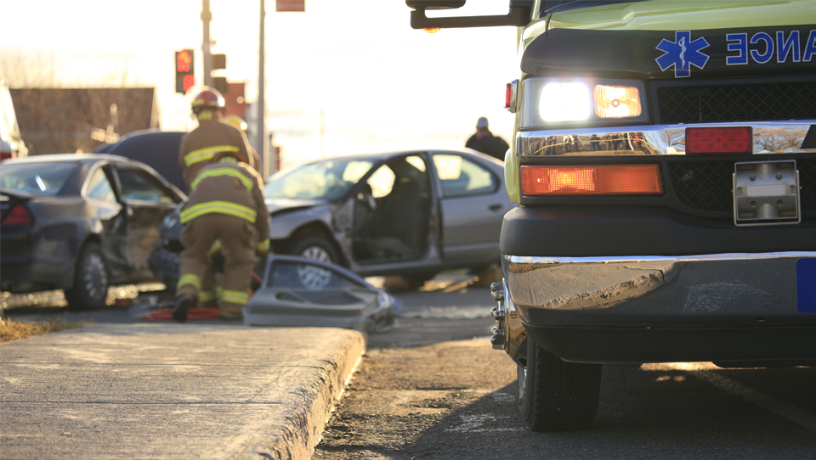
Texting While
Driving Causes:
1,600,000 accidents per year
330,000 injuries per year
11 teen deaths EVERY DAY
25% of ALL car accidents
8
Notes:
**Read, pause for reaction/impact/commentary

Slide 9
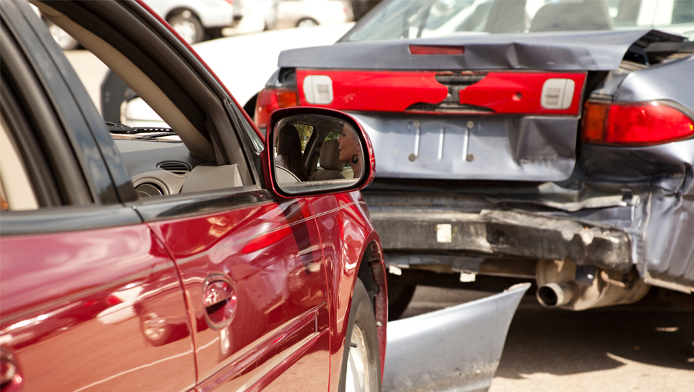
Texting While Driving:
Makes you 23X more likely to crash
Is the same as driving blind for 5 seconds at a time
Is the number one distraction for teen drivers
9
Notes:
**Read, pause for reaction/impact/commentary

Slide 10


Slide 11

Oklahoma’s Texting While Driving Law
While Car is Moving
No Texting
No looking at the screen
$100 fine
GPS and music are okay to use as long as you’re not distracted
11
Notes:
**Read, pause for reaction/impact/commentary

Slide 12
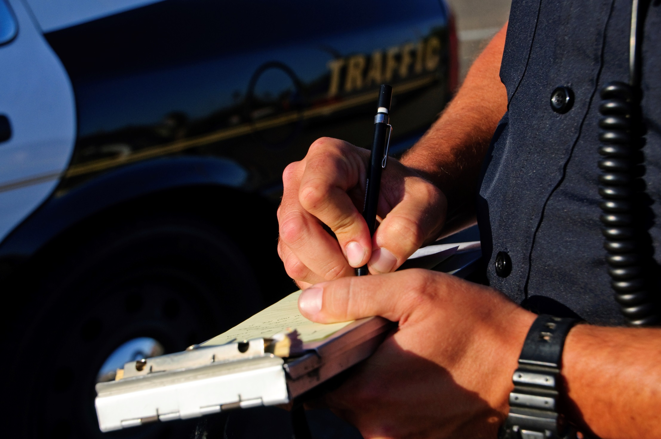
Did you know …
A 16-year-old is 2x more likely to get a traffic ticket than any other driver.
Notes:
**Read, pause for reaction/impact/commentary

Slide 13
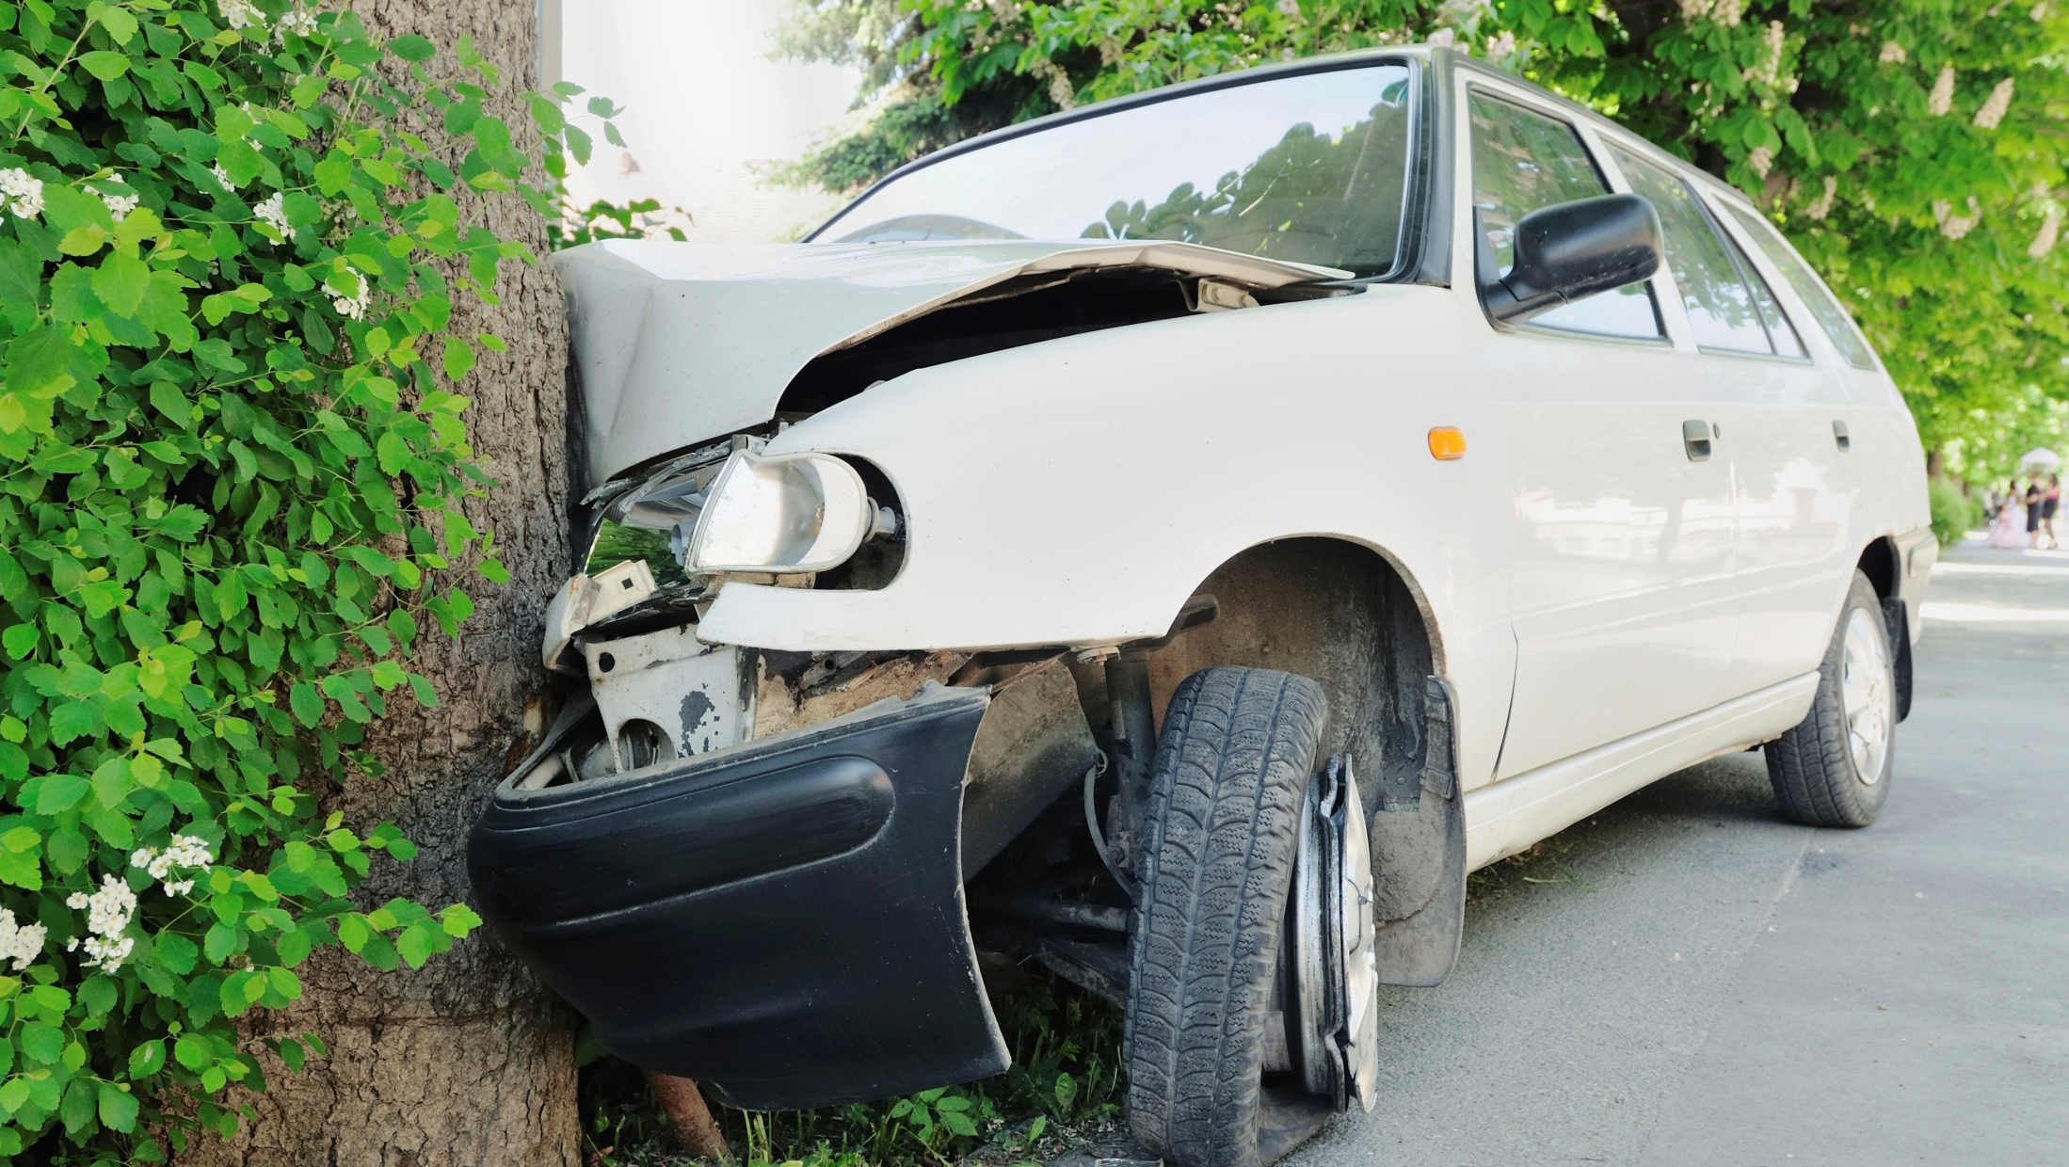
Did you know …
Teen drivers with passengers are 3.6x more likely to be involved in a fatal crash than teens driving alone.
Notes:
**Read, pause for reaction/impact/commentary

Slide 14

Did you know …
Only 44% of teens say they would speak up if someone was driving in a way that scared them.
Notes:
**Read, pause for reaction/impact/commentary

Slide 15
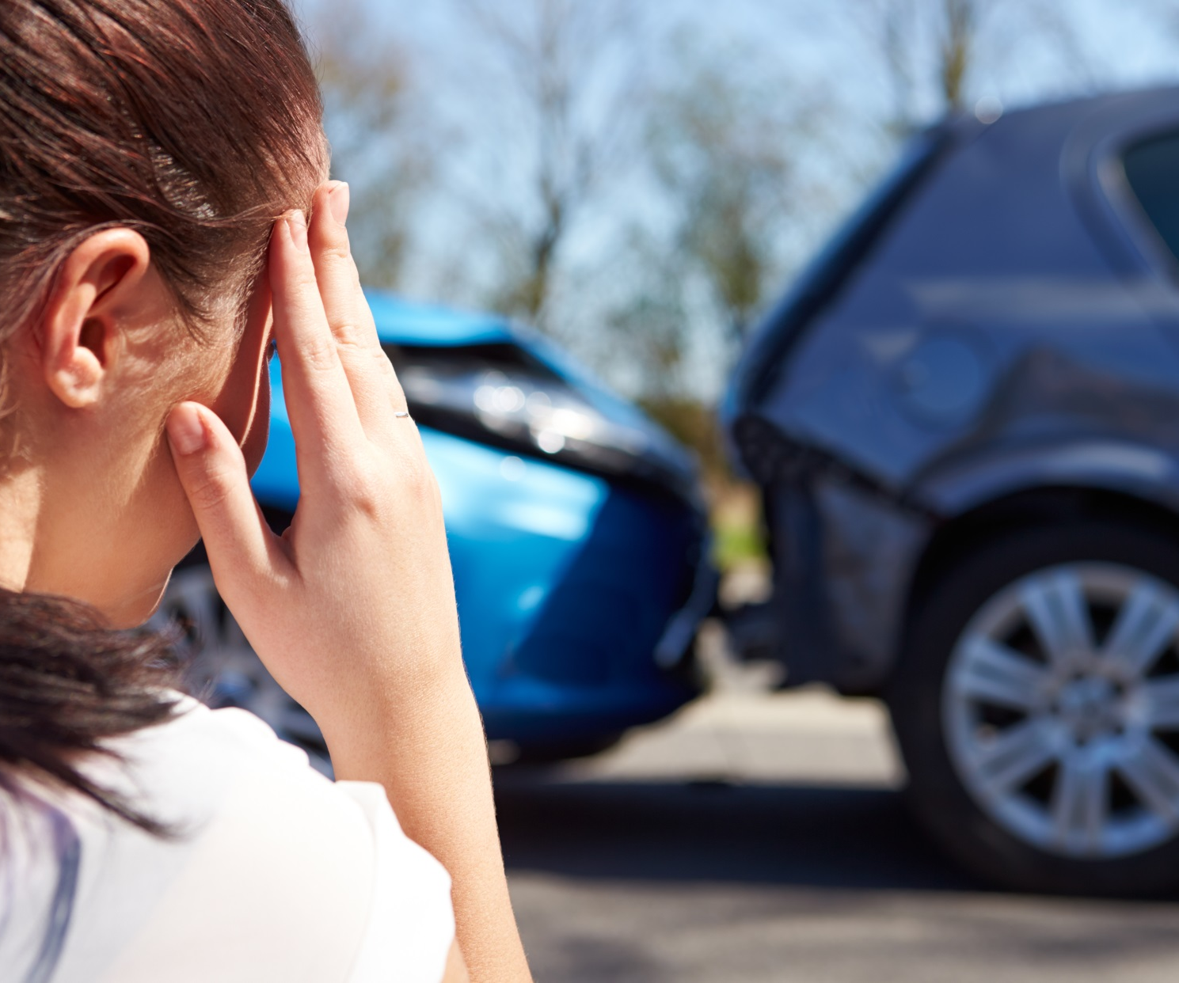

Why should you care?
15
Notes:
**So why should you care?
**Everyone talks about the physical risks of bad driving – you can die, you can kill someone or more likely you end up in a wheelchair for the rest of your life.

Slide 16

Why should you care?
Notes:
**But dumb driving decisions can be pretty devastating HERE, in your pocket.
Presentation Support
As you’ll see, financial pain of bad driving can be just as long-term.
You can wreck your credit score, which could keep you from getting a job, or qualifying for an apartment.
So what now?

Slide 17

INSURANCE 101 for Teen Drivers
Because what you don’t know CAN hurt you
Notes:
**Today’s course (read name above) is “what now.”
Presentation Support
Not feeling very money-smart when it comes to insurance?
Pay attention. You might be surprised how much you already know.

Slide 18
Today’s Agenda
Auto Insurance 101
The basics
Get Smart Challenge
Request A Quote
It’s Your Choice
Money-smart driving is in your hands
Notes:
**The course has three parts – you get to THINK, ACT, and even PLAY. Multiple ways to help you remember what you learn. And yes, there will be a quiz at the end.
Presentation Support
Auto Insurance 101 is a 10 minute definition of terms. Pay attention or you might have a tough time with parts 2 and 3.
Once you know the basics, it’s time to “show you the money,” actually buy auto insurance coverage in the Get Smart Challenge.
And finally, we’ll take that new insurance for a test drive with the “It’s Your Choice” game.

Slide 19
Auto Insurance Basics
What teen drivers need to know
Notes:
**So let’s learn some basic terms. I’m going to hand out a cheat sheet to help you follow along. But you might want to take some notes, as this will be on a quiz later.
Handout Definitions of Terms

Slide 20


1. Auto insurance policy
What you pay the insurance company for covering your RISK.
Your notice to the insurance company that a loss has occurred.
The cost in dollars of property damage or injuries covered in your policy.
The maximum amount you will receive for a specific type of coverage.
What you pay out of pocket, before the insurance pays your claim.
A legal contract between you and the insurance company. You agree to pay a premium and when you have a claim, the insurance company agrees to pay losses up to certain limits, after deductibles.
Notes:
**An auto insurance policy is a legal CONTRACT between you and your insurance company.
Presentation Support
(Read copy on slide and sidebars; expand definitions as time permits)
Premium – What you pay the insurance company for covering your risk. Payment can be weekly, monthly, every six months, or even once per year.
IDEA: You pay a little now to avoid paying A LOT later, when something bad happens. Insurance spreads cost of accidents across multiple drivers; makes costs lower for all.
Claim – Notification to the insurance company that you’ve suffered a loss.
Key question when deciding whether or not to file – damages vs. deductibles. Consult a trusted adult.
Consult insurer for best way to file – agent, by phone, online.
Losses – The cost in dollars of covered property damage or injuries defined in your policy.
Limits – Maximum amount of protection in a policy for a specific type of coverage.
Deductibles – What you pay out of pocket before insurance reimbursement kicks in.
Applies only to two coverage types: comprehensive and collision.
As a rule, the higher your deductibles, the lower premium.

Slide 21
2. What is covered?
Pays for theft, or damage to your car not caused by a collision, i.e., vandalism, weather.
Pays for damage to your car caused by hitting something, i.e., a wall, vehicle.
Pays for injuries that happen to others in an auto accident that is your fault.
Pays accident-related medical bills for you and your passengers, regardless of who’s at fault.
Pays for damage to others’ property resulting from an auto accident that is your fault.
Pays for injuries caused by a driver who doesn’t have insurance.
Pays for injuries caused by a driver who doesn’t have enough insurance to cover your loss.
Most auto insurance policies include these standard benefit types: comprehensive, collision, bodily injury, medical or personal injury, property damage liability and uninsured or underinsured motorist. Each exists to “cover” or protect you from significant financial loss.
Notes:
**Most insurance policies include these specific benefits types to protect you from significant financial loss.
Presentation Support
(Read copy on slide and sidebars; expand definitions as time permits)
Comprehensive – pays for damage to your vehicle caused by something other than a crash or collision, i.e., fire, vandalism, theft, falling objects like a tree, hitting potholes or objects flying at you, i.e., a bird or deer.
Usually required by the lender if you have a loan.
Collision – pays for damage to your vehicle caused by you striking something, a vehicle, a pole, tree.
Usually required by the lender if you have a loan.
Bodily injury – pays for injuries and damages to others from an accident in which you are at fault.
Usually required by state law (not New Hampshire).
Conditions and restrictions vary by state for when a policyholder is allowed to sue another party for auto-related injuries.
Medical Payments or Personal Injury Protection – pays medical bills for you and your injured passenger, regardless of who was at fault.
Usually required by state law.
Rules, limitations and monetary thresholds for filing a claim vary by state.
Property damage liability – pays for damages to someone’s property from an accident in which you are at fault.
Uninsured motorist – pays for injuries (not property damage) to you and your passengers from an accident caused by a motorist who does not have insurance.
Underinsured motorist – pays for injuries (not property damage) to you and your passengers from an accident by a motorist without enough insurance to pay your claim.

Slide 22
3. Who is covered?
Operator of the insured auto or any licensed person who has permission to drive.
Person inside the auto, other than the driver, injured in a covered accident.
Person outside the auto who suffers a loss due to a covered accident.
Drivers, passenger(s) and pedestrians all may be eligible to receive financial benefits if injured in a covered accident.
Notes:
**Auto insurance is attached to the VEHICLE. If the car is covered, insurance protects any of three roles likely affected by an accident or incident.
Presentation Support
(Read copy on slide and sidebars; expand definitions as time permits)
Driver – operator of the insured auto or any licensed person who has permission to drive.
Passenger – anyone in the car with the driver of a covered auto who suffers a loss in an accident or incident that is your fault.
Pedestrian – anyone outside the covered auto who suffers a loss in an accident that is your fault.
Note: In a two/multi car accident with injuries or damages:
The at-fault driver receives MEDICAL benefits – medical bills and lost wages.
The person deemed not at fault is eligible for BODILY INJURY benefits – $ amount takes into account medical bills, rehab costs, etc., but allows broader (often higher-dollar) payment for “pain and suffering.” (If an accident is your fault, you can’t receive pain and suffering from your own insurance policy.)

Slide 23
4. How to buy
A statement detailing the premium you will pay for the specific coverage you request.
A local professional paid by an insurance company to sell policies.
Purchase from the insurance company without the help of an agent.
Once you decide what types and how much auto insurance coverage you need, you can request a quote through an insurance agent or direct, by phone or online.
Notes:
**There are several ways to buy insurance; decision based on your knowledge and comfort level with the process.
Presentation Support
(Read copy on slide and sidebars; expand definitions as time permits)
Quote – Statement, i.e., quotation, from the insurance company of the cost (your premium) and coverage (benefits) of the policy you negotiate.
Final quote may change during the underwriting process when the company verifies information you provided.
Agent – person hired by insurance company to sell auto insurance policies.
Independent agents compare and sell policies from multiple companies.
Captive agents sell for only one company.
Direct – buying from the insurance company online or over the phone, without the input of an agent.
Pros/Cons
AGENT
Sells hundreds of policies, access to multiple companies’ policies, personal, can provide situation-specific guidance, help with filing a claim. Negatives: Not available 24/7; may have a bias for one company over another.
DIRECT
May save time and costs to insurer, which could mean lower premiums. Negatives: No human interaction, not personal, call center rep scripted, may not offer specific help.

Slide 24
Get Smart Challenge
Request A Quote
Notes:
**Part 1 is done. Now that you know the basics, let’s buys some insurance.

Slide 25

Get Smart Challenge Jack’s New Ride
17 years old
Instagram addict
Part-time job
Track, tennis and debate teams
Girlfriend … sometimes
Gear is always right
Notes:
**Mentioned a few times that insurance is personal. To buy a policy, we need a person. That’s why we created Jack. Let’s see how much he has in common with you.
Presentation Support
(Read Jack’s bio, expand descriptions below, open to students to add other traits that might impact auto insurance purchase)
Tried to paint Jack as the average teenager
A 17 year old high school junior, does okay in school with a B+ average.
Has a part-time job and an on again, off again girlfriend
Jack loves Instagram; at last count he had posted 1,614 images
With track, tennis and debate, Jack’s always at school before or after class
Just because he’s busy doesn’t mean he can’t look good. Jack is all about style

Slide 26
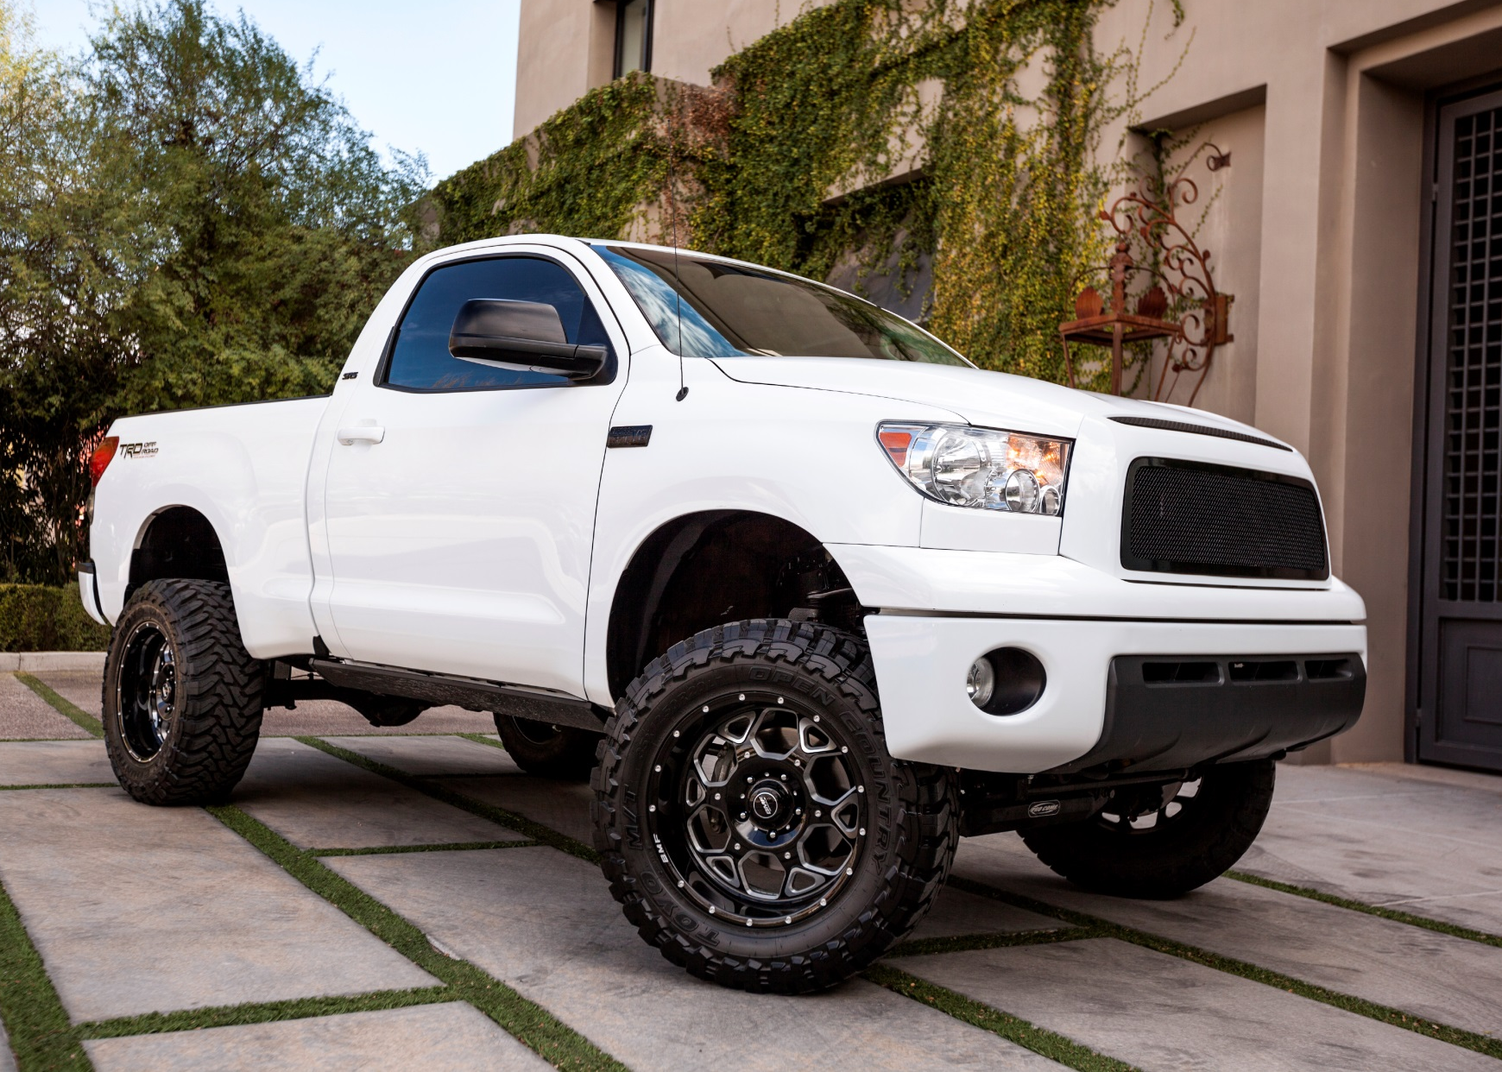
Get Smart Jack’s New Ride
2008
Toyota Tundra
Value
$8,000
Car Payment
$135
26
Notes:
**What you might pay for insurance depends heavily on Jack, and the vehicle he drives.
Insurance company rule of thumb: The less money they anticipate you will cost them (in number and size of claims), the lower your premium.
CAUTION: Company-to-company rate differences are dramatic — as much as $1,000 a year. SHOP AROUND.
Presentation Support
What insurance companies consider when setting your premium:
Car make, model and age (luxury and sports cars are higher)
Annual mileage (the more you drive, the higher the risk)
Where you live (higher premiums for urban vs. rural)
Marital status (married people have fewer claims)
Experience, # of years driving
Gender (boys have more accidents than girls)
Past driving record/prior insurance: lots of accidents, cancelled for non-payment = higher premiums
Teen-specific considerations:
Good grades = lower premiums
Typical behaviors = higher premiums: Teens tend to speed, not wear seat belts, drive distracted (texting, Instagram, drinking), especially with friends in the car
Let’s see how all this translates into an auto policy for Jack.

Slide 27
Get Smart: Request a Quote
Required Coverage | Limits | Monthly Premium
Medical or Personal Injury | $5,000 | $10
Bodily Injury | $15,000 per person $30,000 per accident | $25
Property Damage Liability | $5,000 | $20
Collision | $500 deductible | $25
Comprehensive | $250 deductible | $10
Uninsured and Underinsured Motorist | $15,000 per person $30,000 per accident | $10
Notes:
**We discussed coverage types earlier. Given the kind of car Jack owns and the fact that he has a loan, these are the coverage types most applicable to his needs.
Presentation Support
(READ content on slide; review definitions if needed).
Medical or Personal Injury Protection (what this is called differs by state) – pays medical bills for you and your injured passenger, regardless of who was at fault.
Bodily injury – pays for damages to others from an accident in which you are at fault. (Conditions and restrictions vary by state for when a policyholder is allowed to sue another party for auto-related injuries.)
Property damage liability – pays for damages to someone’s property from an accident in which you are at fault.
Collision – pays for damage to your vehicle caused by you striking something, a vehicle, a pole, tree.
Comprehensive – pays for damage to your vehicle caused by something other than a collision, i.e., fire, vandalism, theft, falling objects or objects flying at you, i.e., a bird or deer.
Uninsured Motorist – pays for injuries (not property damage) to you and your passengers from an accident caused by motorist who does not have insurance.
Underinsured motorist – pays for injuries (not property damage) to you and your passengers from an accident caused by motorist who does not have enough insurance to pay your claim.

Slide 28

Get Smart Challenge
Jack’s Monthly Premium: $100
Jack’s Deductibles: $500/$250
Notes:
**So total all that information and here’s what we find.
Jack’s premium, how much he pays the insurance company each month, is $90.
But if Jack has an accident or incident that requires him to file a claim, what he has to pay out of pocket, his deductible, is quite a bit more.
Every time Jack hits something or someone, he’s out $500.
If his truck is damaged by something else, like a tornado, it will cost him $250.
As you’ll see later when we play the game, these costs can add up quickly.

Slide 29
Get Smart: Request a Quote
Optional Coverage | Limits | Premium
Uninsured and Underinsured Motorist Property Damage | Actual Cash Value (ACV) | $10
Rental | $1,000 | $2
Towing | $500 | $2
Notes:
**But before we move on, there are a few other coverages Jack might consider depending on the value of his truck and risk where he lives.
Presentation Support
(READ slide, review definitions)
Uninsured motorist property damage – pays for repairs to your vehicle or other property caused by motorist who does not have insurance.
Reimbursement is limited to the actual cash value (ACV) of the vehicle.
Underinsured motorist property damage – pays for repairs to your vehicle or other property caused by motorist who does not have enough insurance to pay your claim.
Reimbursement is limited to the actual cash value (ACV) of the vehicle.
Rental – pays to rent a vehicle after comprehensive or collision loss.
Towing – reimburses for towing and labor costs, disabled vehicle. Only available with comprehensive or collision coverage.
Other things to think about –
Ask for discounts – drivers education, good student, air bags, anti-theft devices.
Check savings based on policy length – lower premiums if you pay annually or six months instead of monthly.
Don’t leave stuff in the car – cell phones, TVs, IPads, custom speakers not attached are not covered, at least in a standard policy.
READ before you sign. You are responsible for accuracy and understanding.

Slide 30
It’s your choice
Money-smart driving game
Notes:
**So what if something BIG does change? Let’s play “It’s Your Choice.”
Game overview
Game will show you first hand the cost of the many driving decisions Jack – and you – make every day.
We’ll present scenarios, you make a choice to go LEFT or RIGHT. Sometimes your choice has a positive financial impact (savings). Other times, not so much.
To keep it simple, this game assumes all of these scenarios happen in the same MONTH.
We will track two costs: premiums – look for the “P;” and deductibles, identified by a “D.”
How it works
Each student gets a worksheet (distribute handout) to keep their own score.
Teacher reads a scenario, asks for a show of hands for which way students want to turn -- LEFT or RIGHT.
Students directed to mark an “X” on the worksheet near a blank line to correspond with to his/her choice: RIGHT hands mark an X on the right; LEFT hands mark an X on the left. (This helps the student REMEMBER which choice he/she made.)
Teacher clicks the TURN sign selected by majority of students.
Teacher reveals the $$ impact on premiums and deductibles; discuss using notes in slides.
Teacher clicks the alternate turn sign. Repeats reveal and discussion.
Student records his/her “score,” i.e., the impact of their choice on premium, deductibles or both, next to the X they wrote down earlier.
Repeat for all game scenarios. (Select “EXIT” at any time to jump to the next scenario)
At the end, students individually add up their answers to see just how much $$ bad decisions can cost them.

Slide 31

You woke up late! No time to eat
and finish that extra credit science project on time.

Slide 32
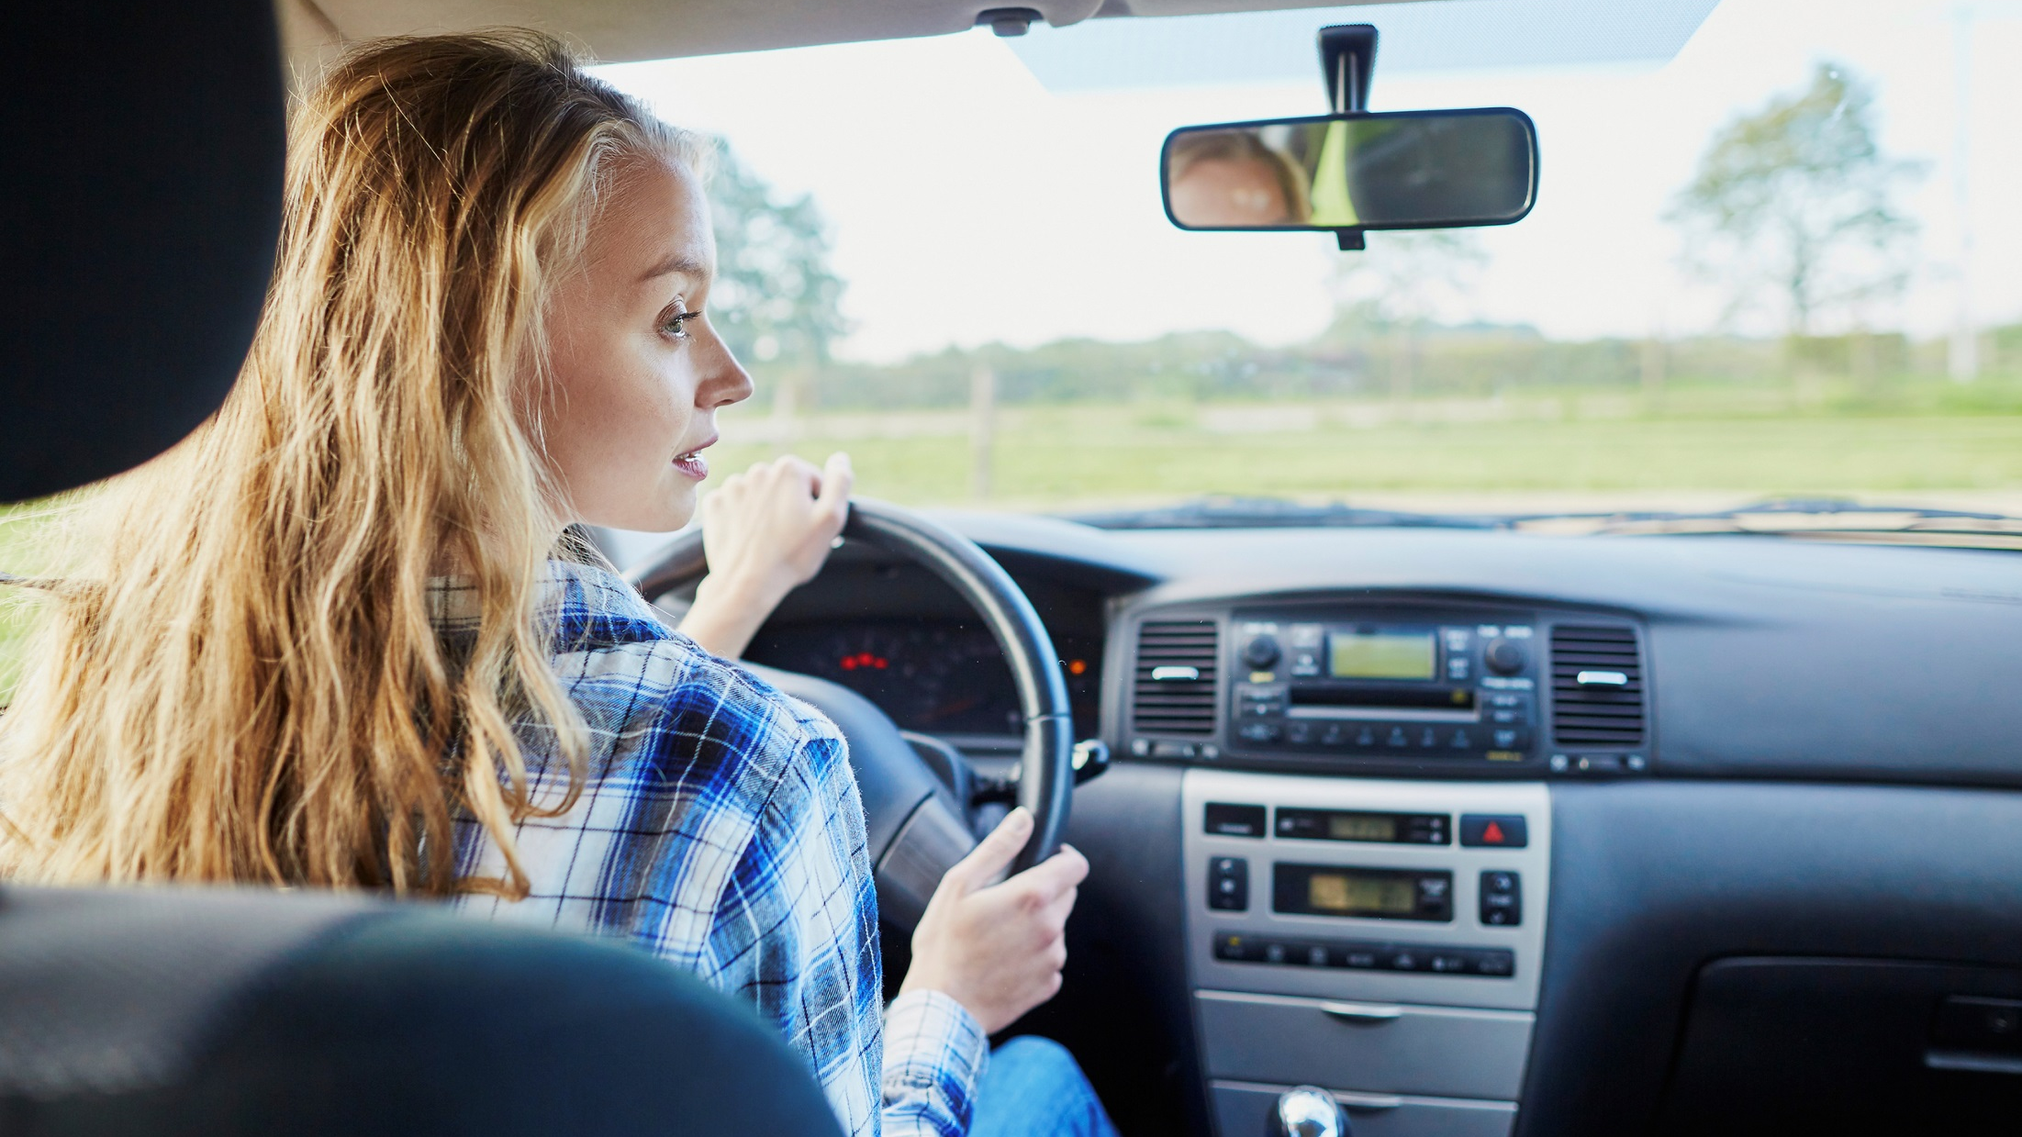

It’s Your CHOICE
MAKE A FAST-FOOD RUN
GO STRAIGHT TO SCHOOL
HIT THE VENDING MACHINE

Slide 33
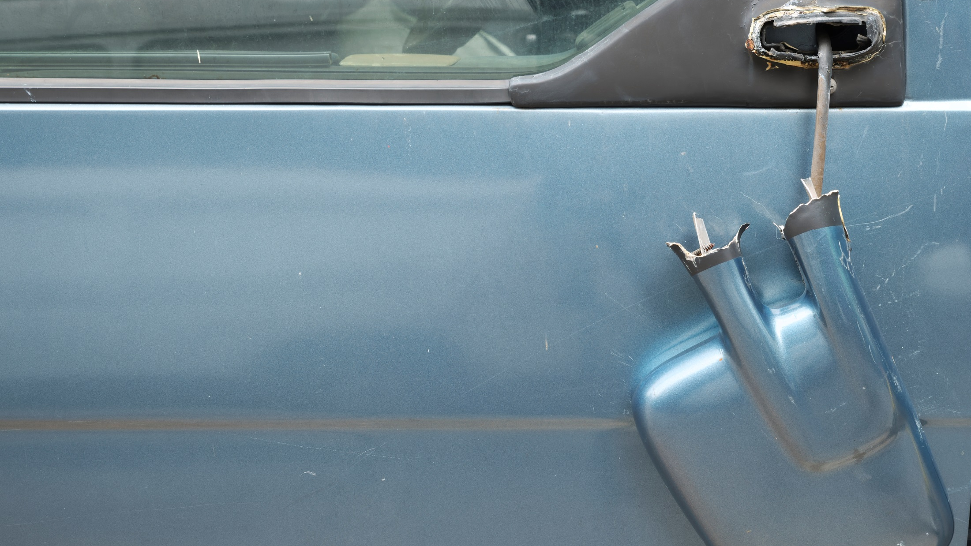




Hit yellow pylon at the drive-thru. Ripped off side mirror.
Pay +$500
GO STRAIGHT TO SCHOOL
HIT VENDING MACHINE
Notes:
**Collision claim, $500 deductible per accident

Slide 34



Science extra credit done.
Increased GPA 2 points.
Subtract -$5
MAKE A FAST-FOOD RUN
Notes:
**Good grades discount

Slide 35

Your half-day class schedule begins today. Sweet!

Slide 36

It’s Your CHOICE
HIT THE GYM
FOR A FEW HOURS
TAKE A RIDE OUT
TO THE LAKE

Slide 37
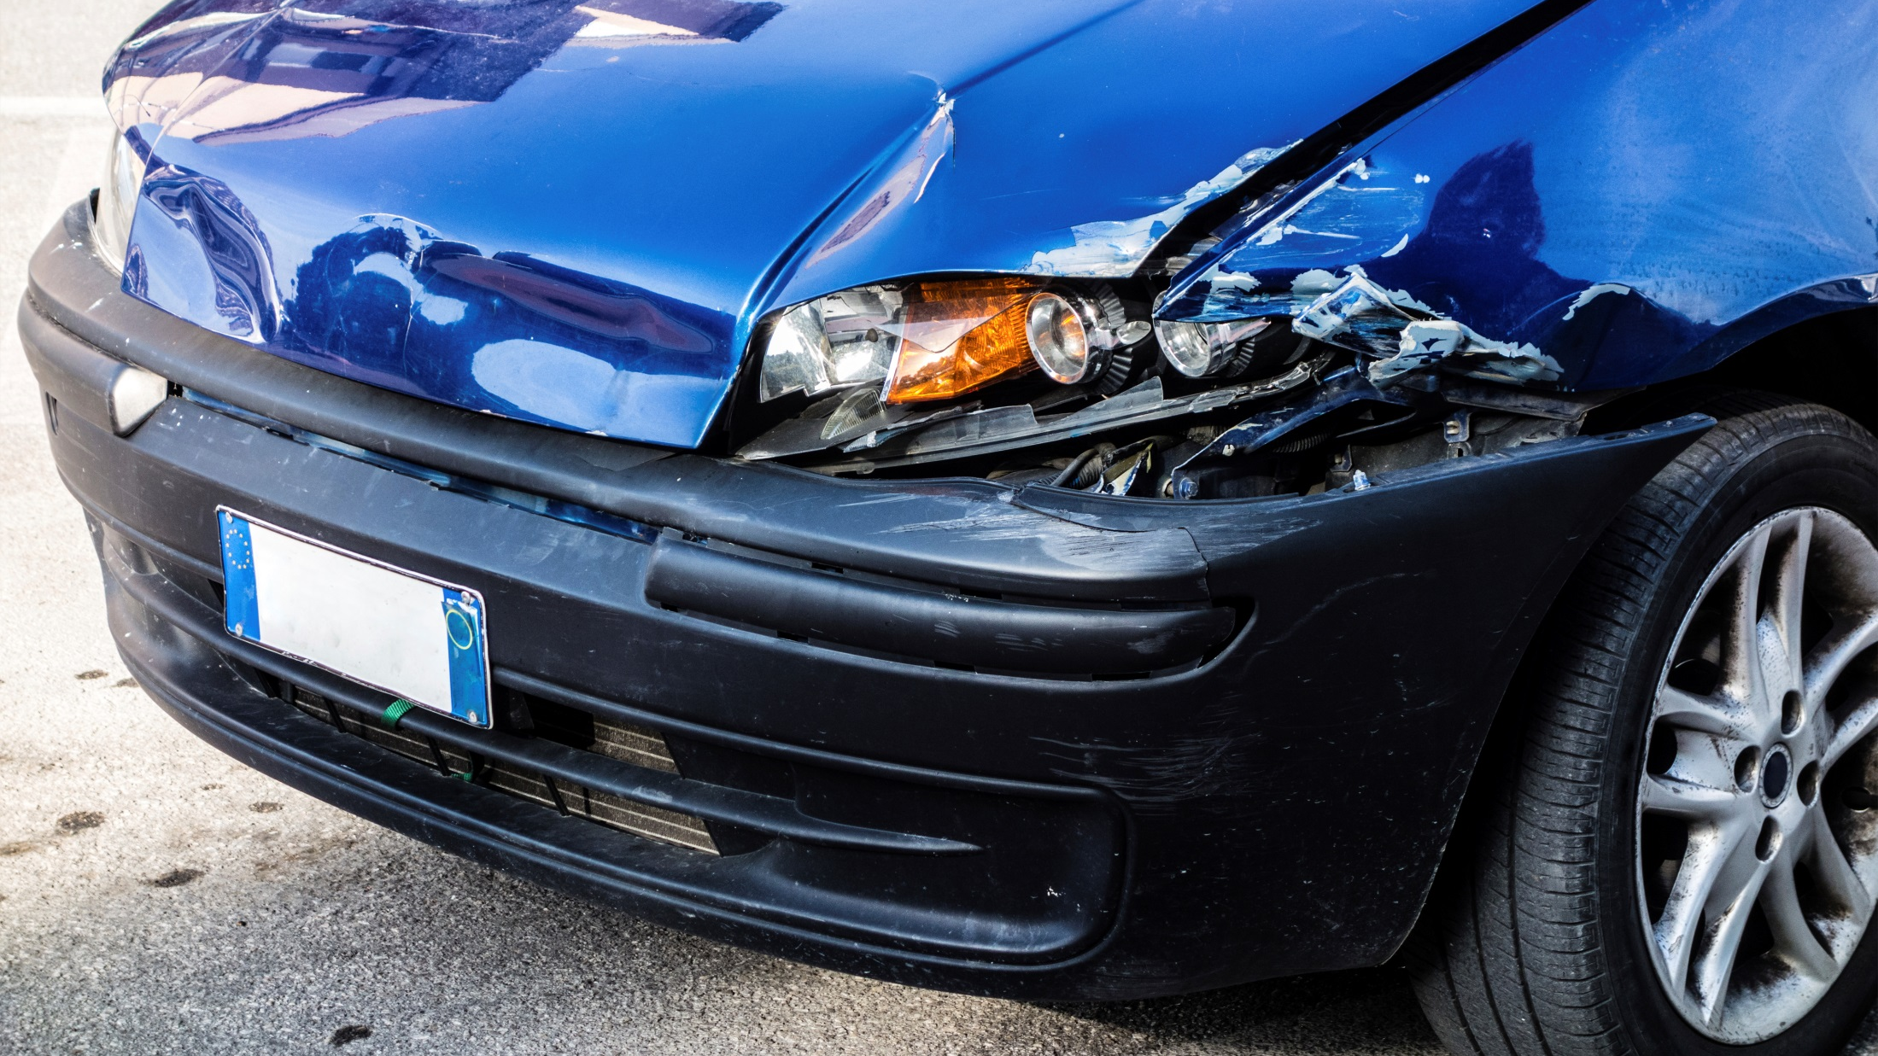
Dinged bumper squeezing into too-tight parking space.
Pay +$500
TAKE A RIDE OUT
TO THE LAKE
Notes:
**Collision claim, $500 deductible per accident

Slide 38
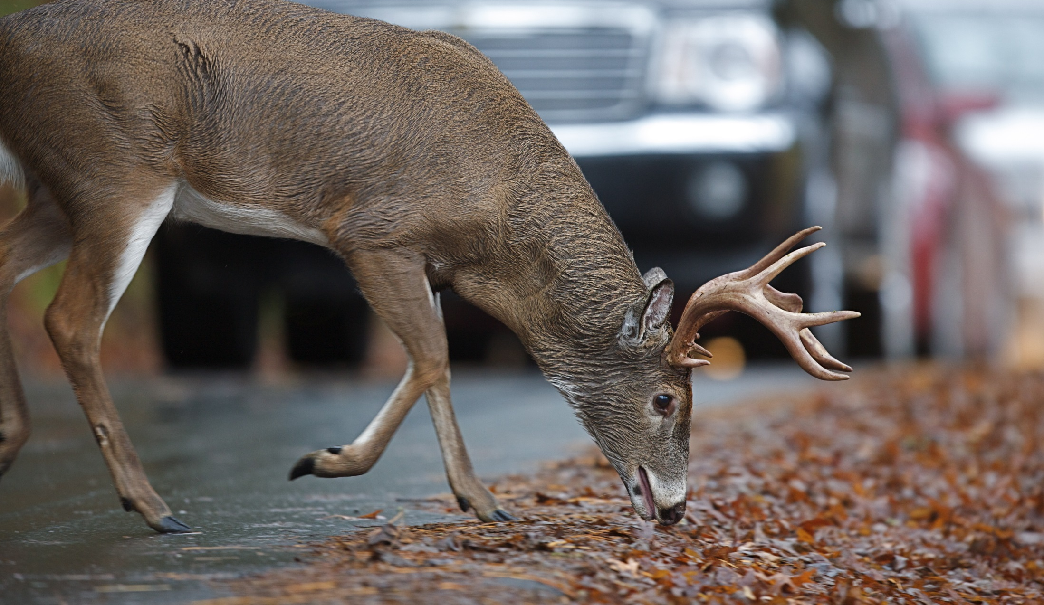
Jamming to the music.
Look out, deer! Busted windshield.
Pay +$250
HIT THE GYM
FOR A FEW HOURS
Notes:
**Comprehensive claim, $250 deductible per accident
(Hitting or being hit by an animal is considered a missile or flying object which makes this comp claim and not collision)
***

Slide 39

Band practice finally over. You need to get home fast to study for that math final.

Slide 40
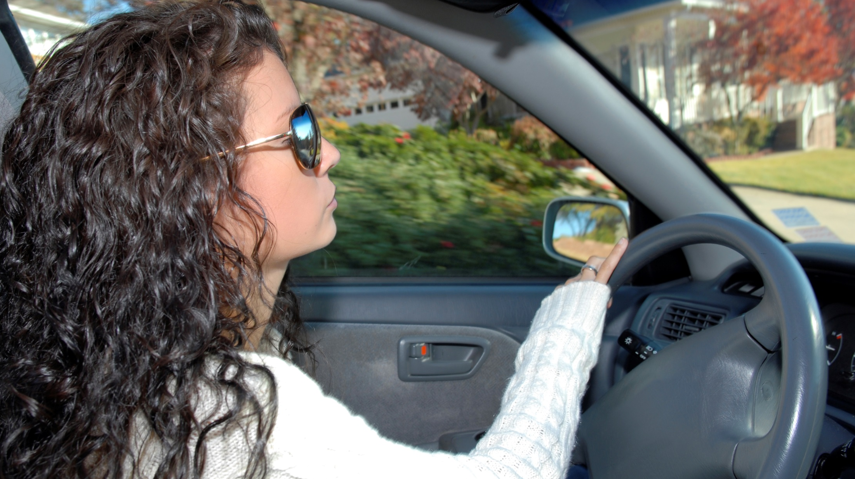
It’s Your CHOICE
TAKE SHORTCUT
THROUGH PARKING LOT
TAKE SIDE ROAD
BEHIND SCHOOL

Slide 41
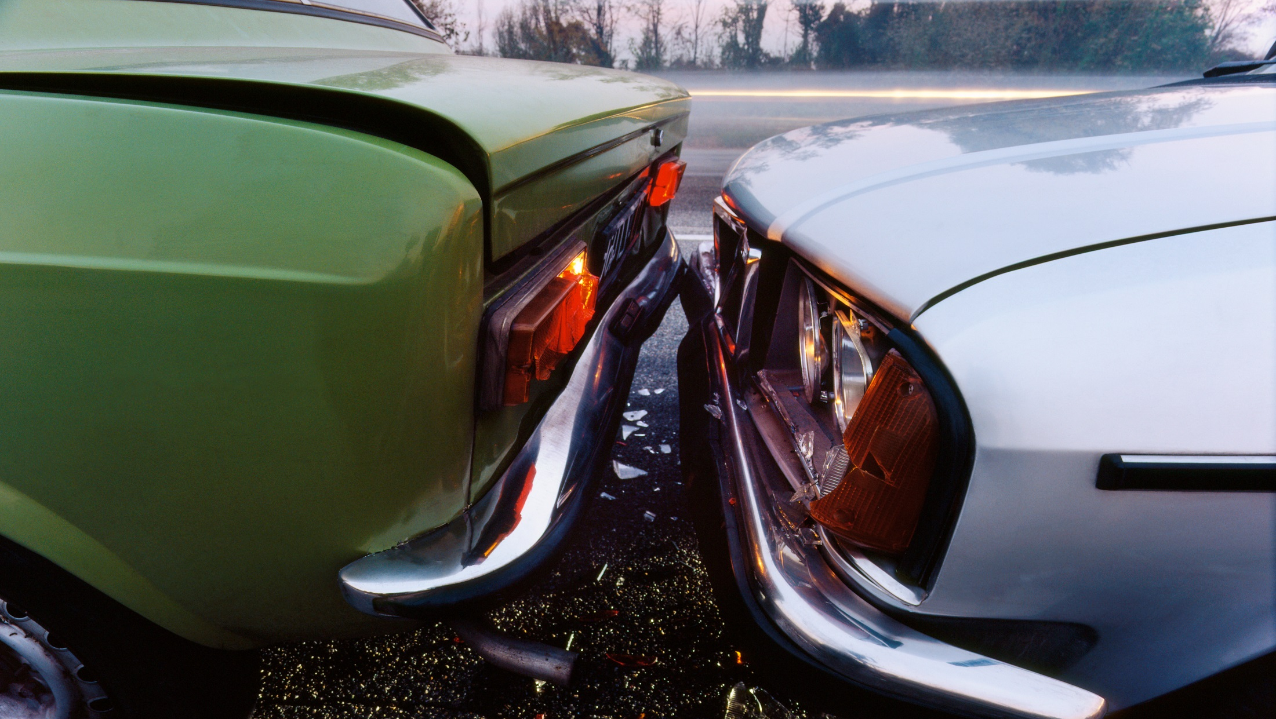
Hit a parked car. Again.
Pay +$500 Add +$5
TAKE SIDE ROAD
BEHIND SCHOOL
Notes:
**Collision claim, $500 deductible per accident
**Multiple car accidents in same month = high risk = increased monthly premium.

Slide 42

No traffic. Home and studying in
6 minutes. Easy A.
Subtract -$5
TAKE SHORTCUT THROUGH PARKING LOT
Notes:
**Good grades discount, 10 to 20 percent—to youths who earn good grades (usually a B average or better).

Slide 43

Prom is eight days away and you have absolutely nothing to wear.
Mall, anyone?

Slide 44

It’s Your CHOICE
MAKE A QUICK
RUN ALONE
PICK UP YOUR CREW
FOR REINFORCEMENTS

Slide 45

Texting while shopping?
No problem.
$hop ‘til you drop!
PICK UP YOUR CREW
FOR REINFORCEMENTS
Notes:
Message: If you know your girls can get you in trouble, shop alone and TXT your great finds!

Slide 46
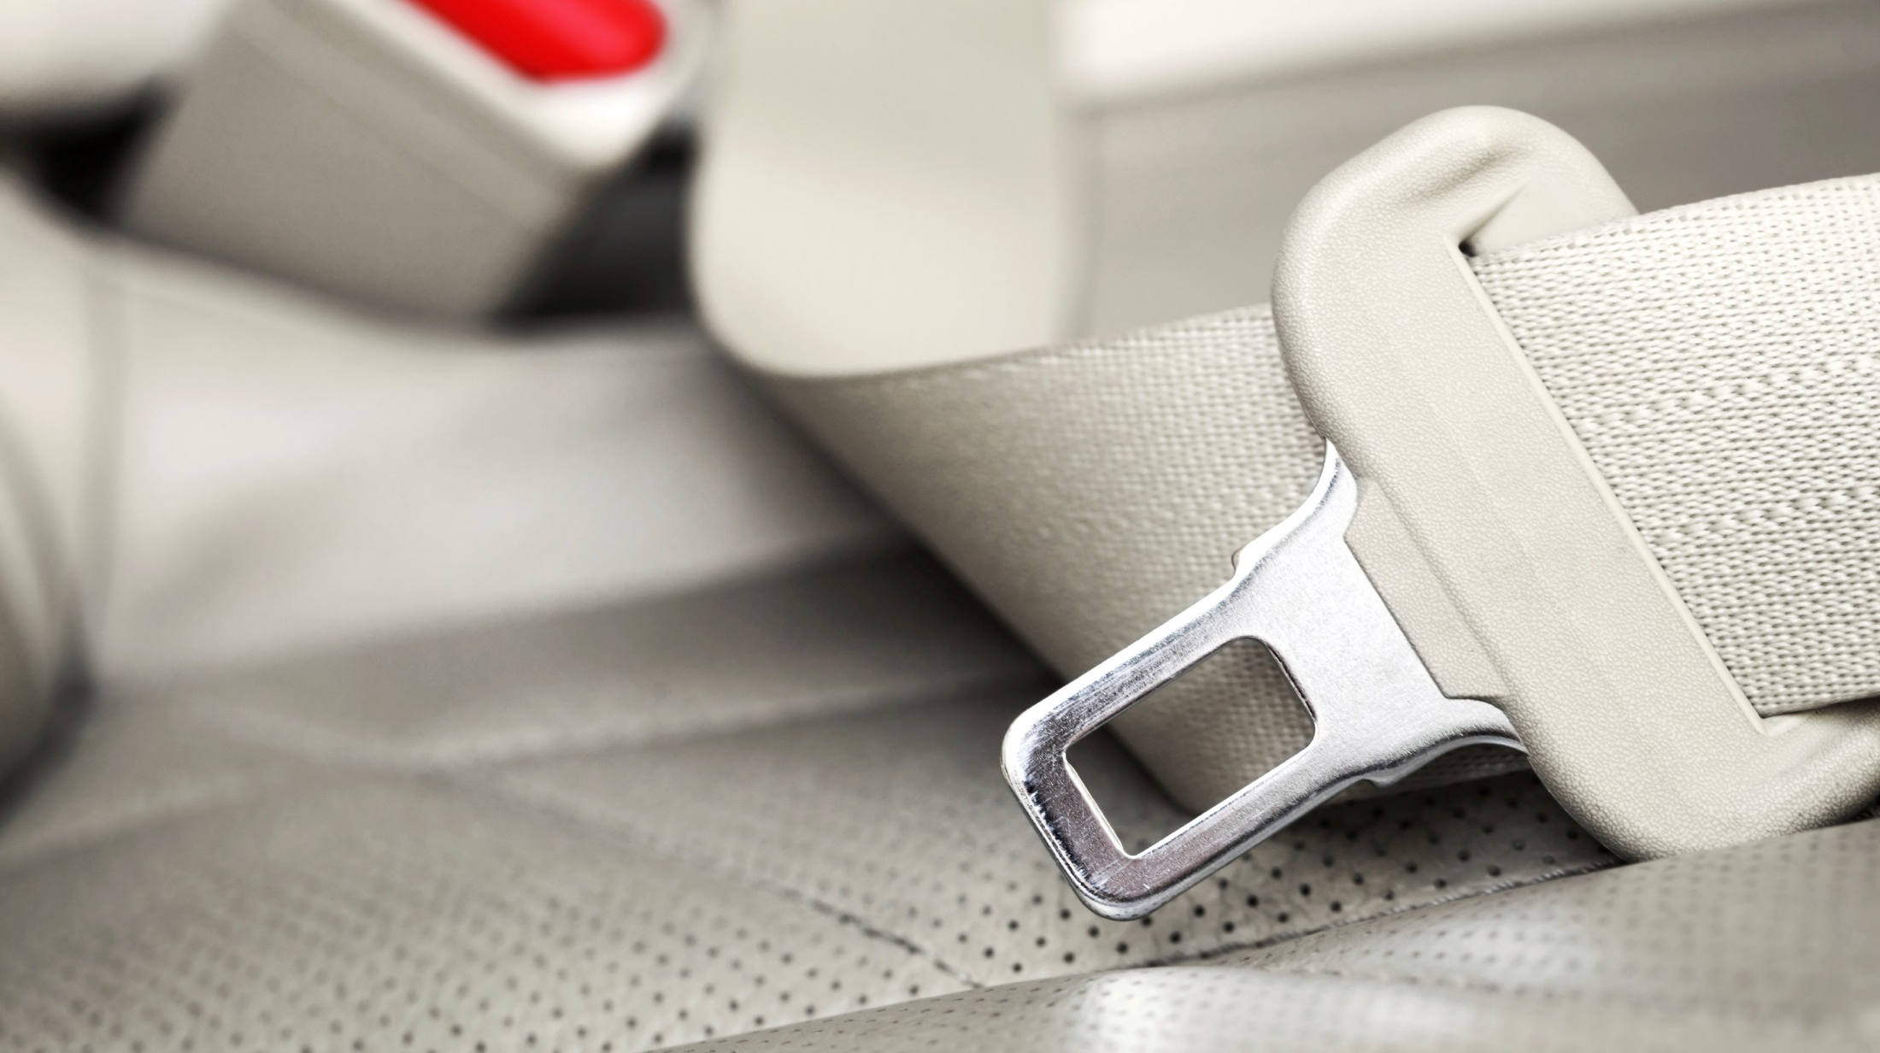
Daredevil divas racing through yellow lights and no seatbelts.
Add +$10
MAKE A QUICK
RUN ALONE
Notes:
**Multiple teens in car = peer pressure = risky behavior.
Police encounters go on your driving record; insurance companies check that record at renewal time; bad news = increased premium.

Slide 47

Time for a study break. You jump in the car to get ice cream.

Slide 48

It’s Your CHOICE
INVITE FRIENDS TO
MEET YOU THERE
CALL AHEAD FOR
TO-GO ORDER

Slide 49
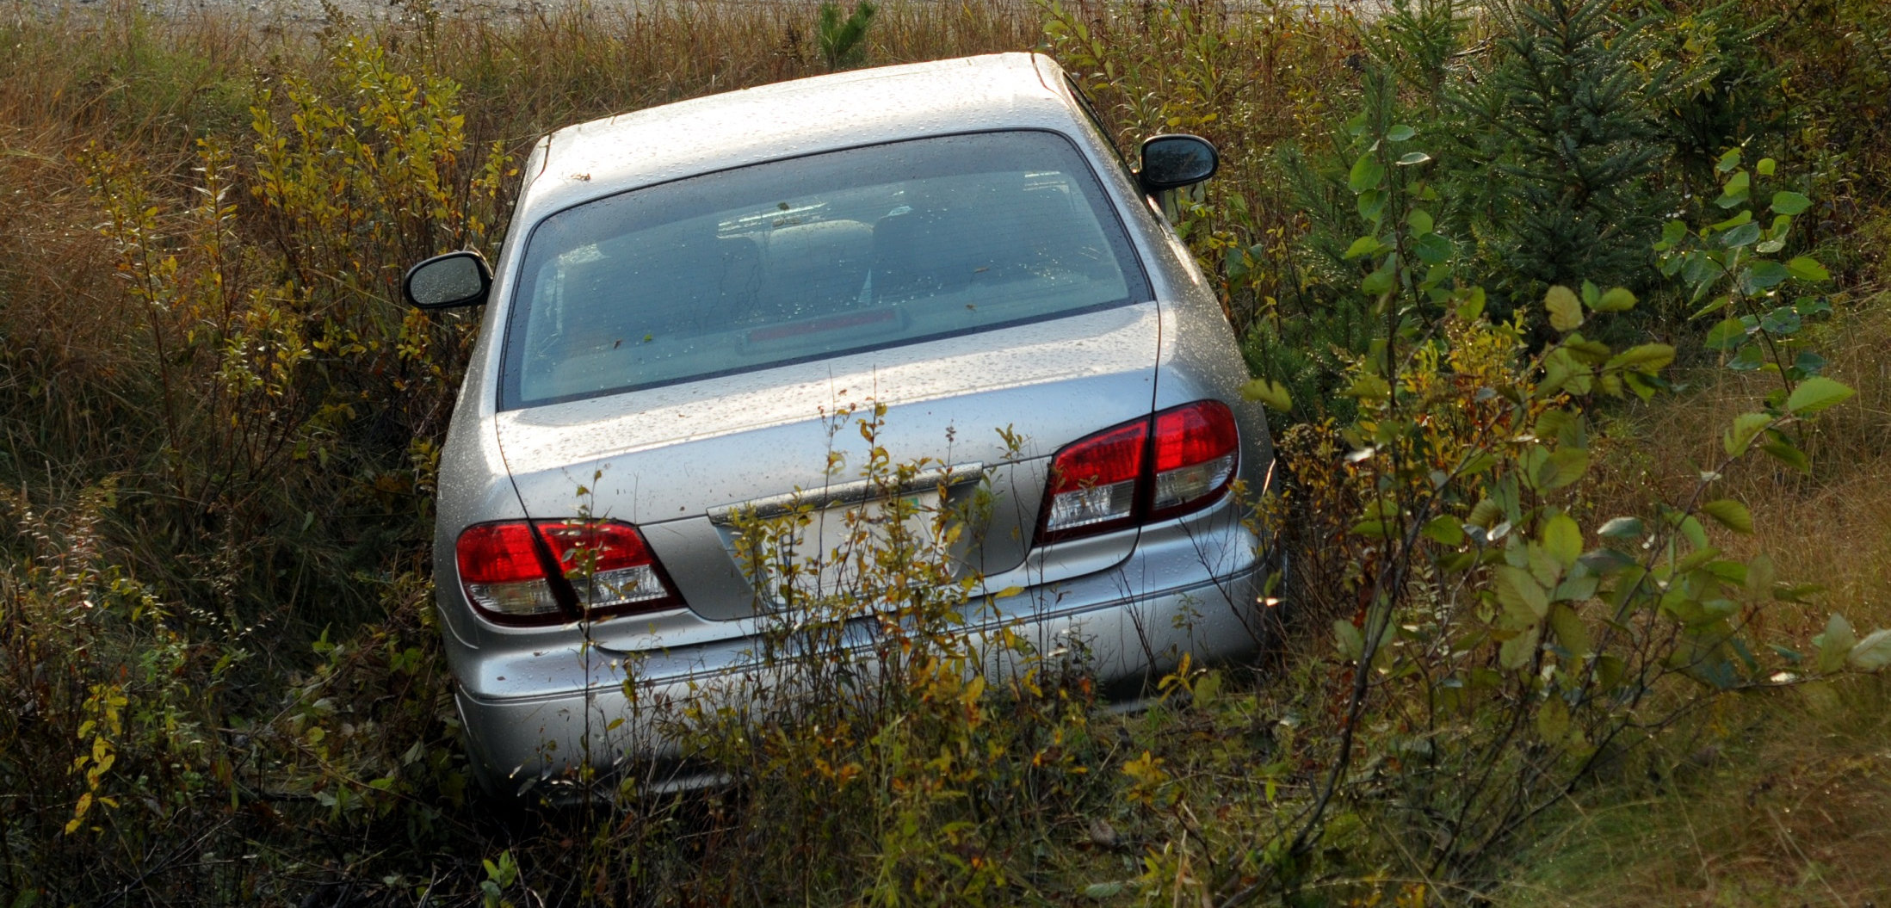
Text ice cream emoji.
Looked away for a second.
BAM! Into a ditch.
Pay +$500
CALL AHEAD FOR
TO-GO ORDER
Notes:
**Collision claim, $500 deductible per accident

Slide 50
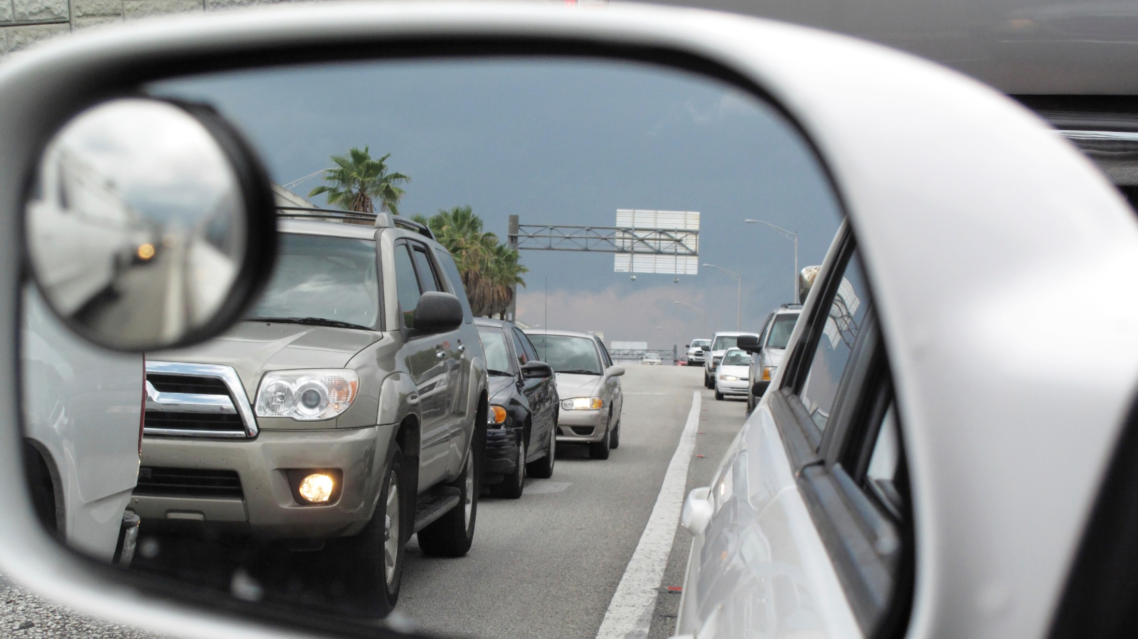
Just missed some dork turning right into your blind spot.
Thank you, Driver’s Ed.
Subtract -$10
INVITE FRIENDS TO
MEET YOU THERE
Notes:
**Driver’s ED premiums discount even better than good grades

Slide 51
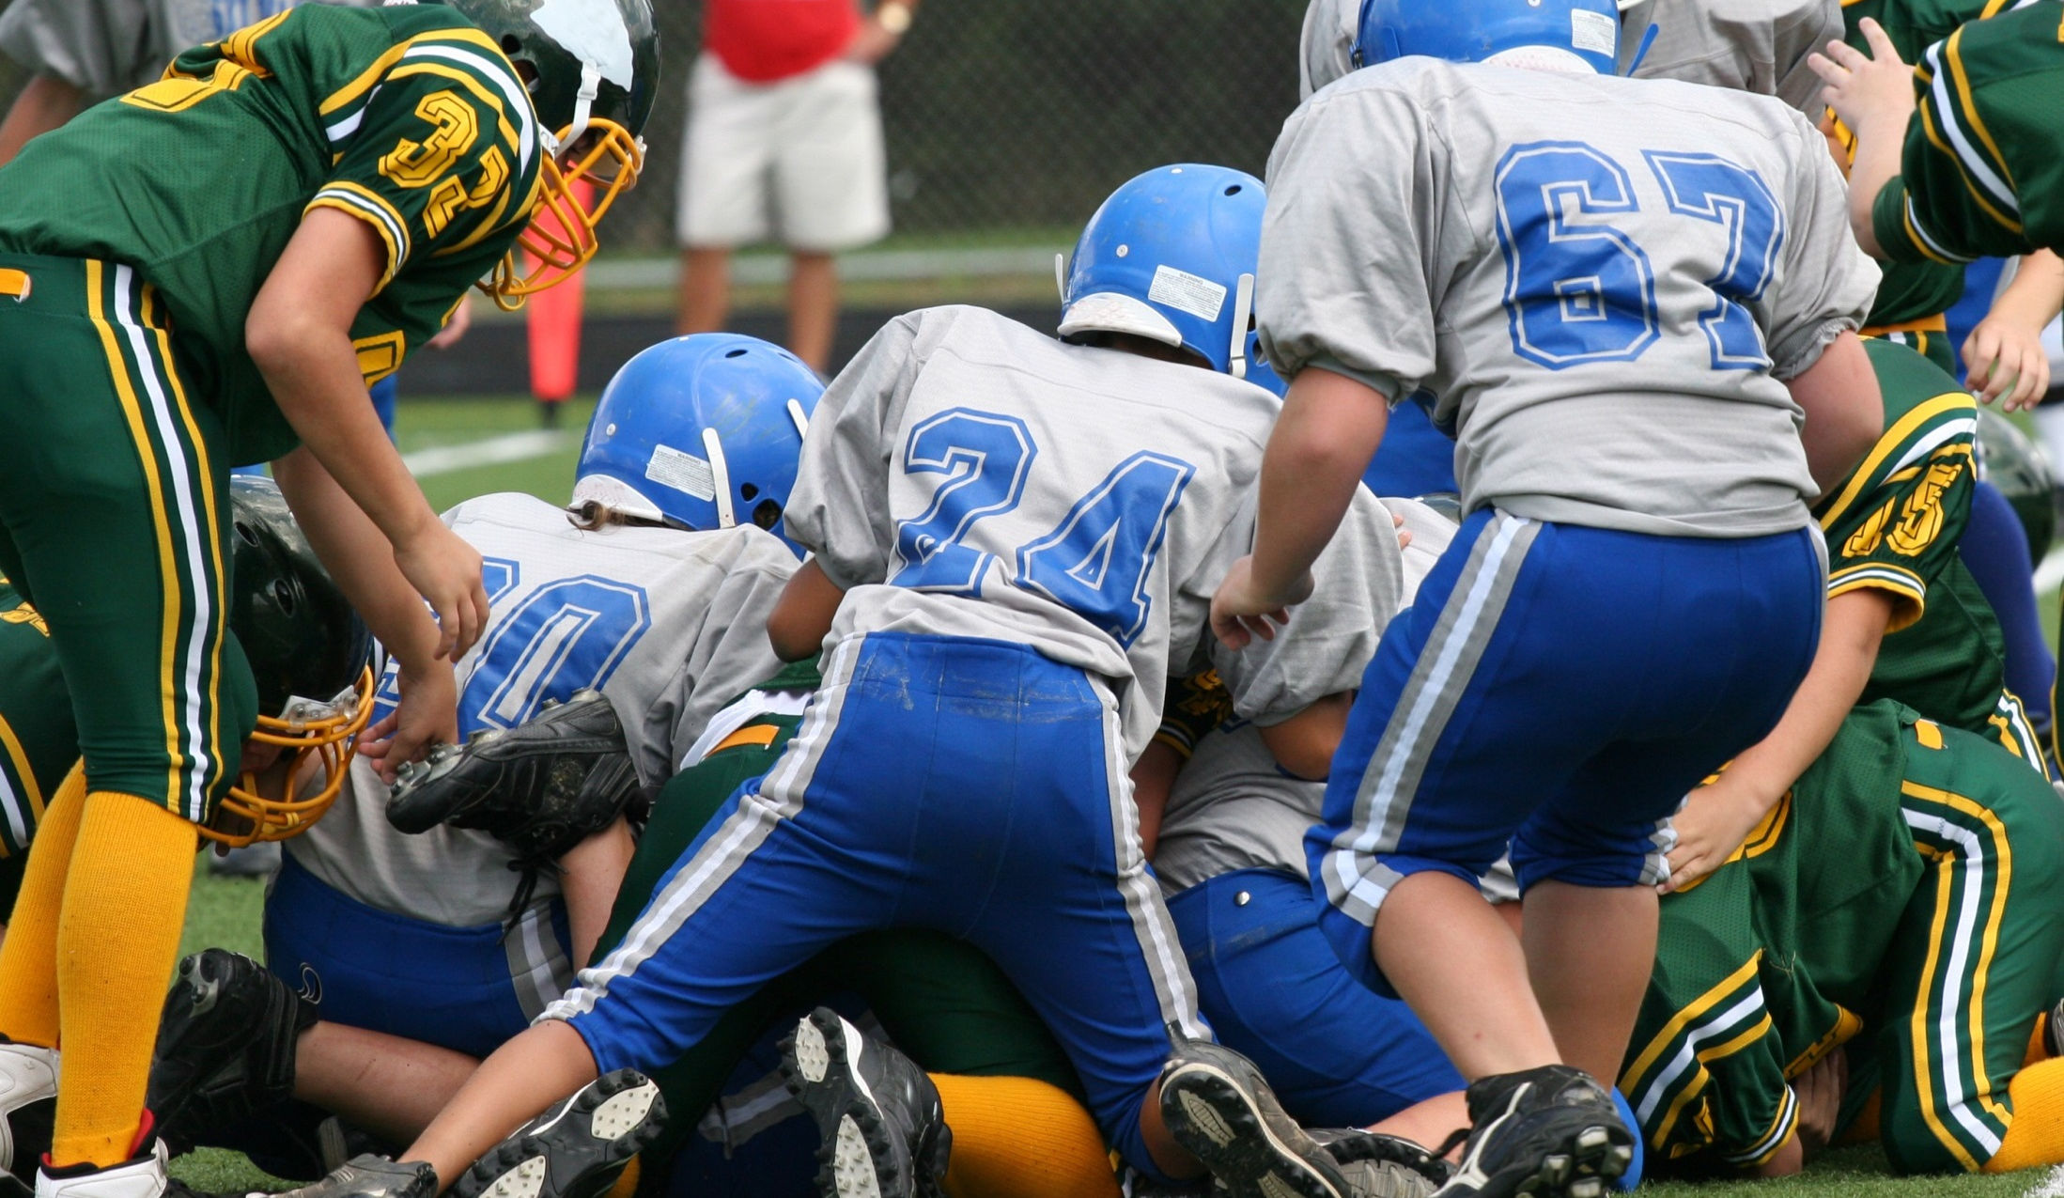
Homecoming weekend. What a game!
Now it’s time to bounce.

Slide 52

It’s Your CHOICE
HEAD TO AFTER-PARTY WITH THE GUYS
GIVE GIRLFRIEND
A RIDE HOME

Slide 53
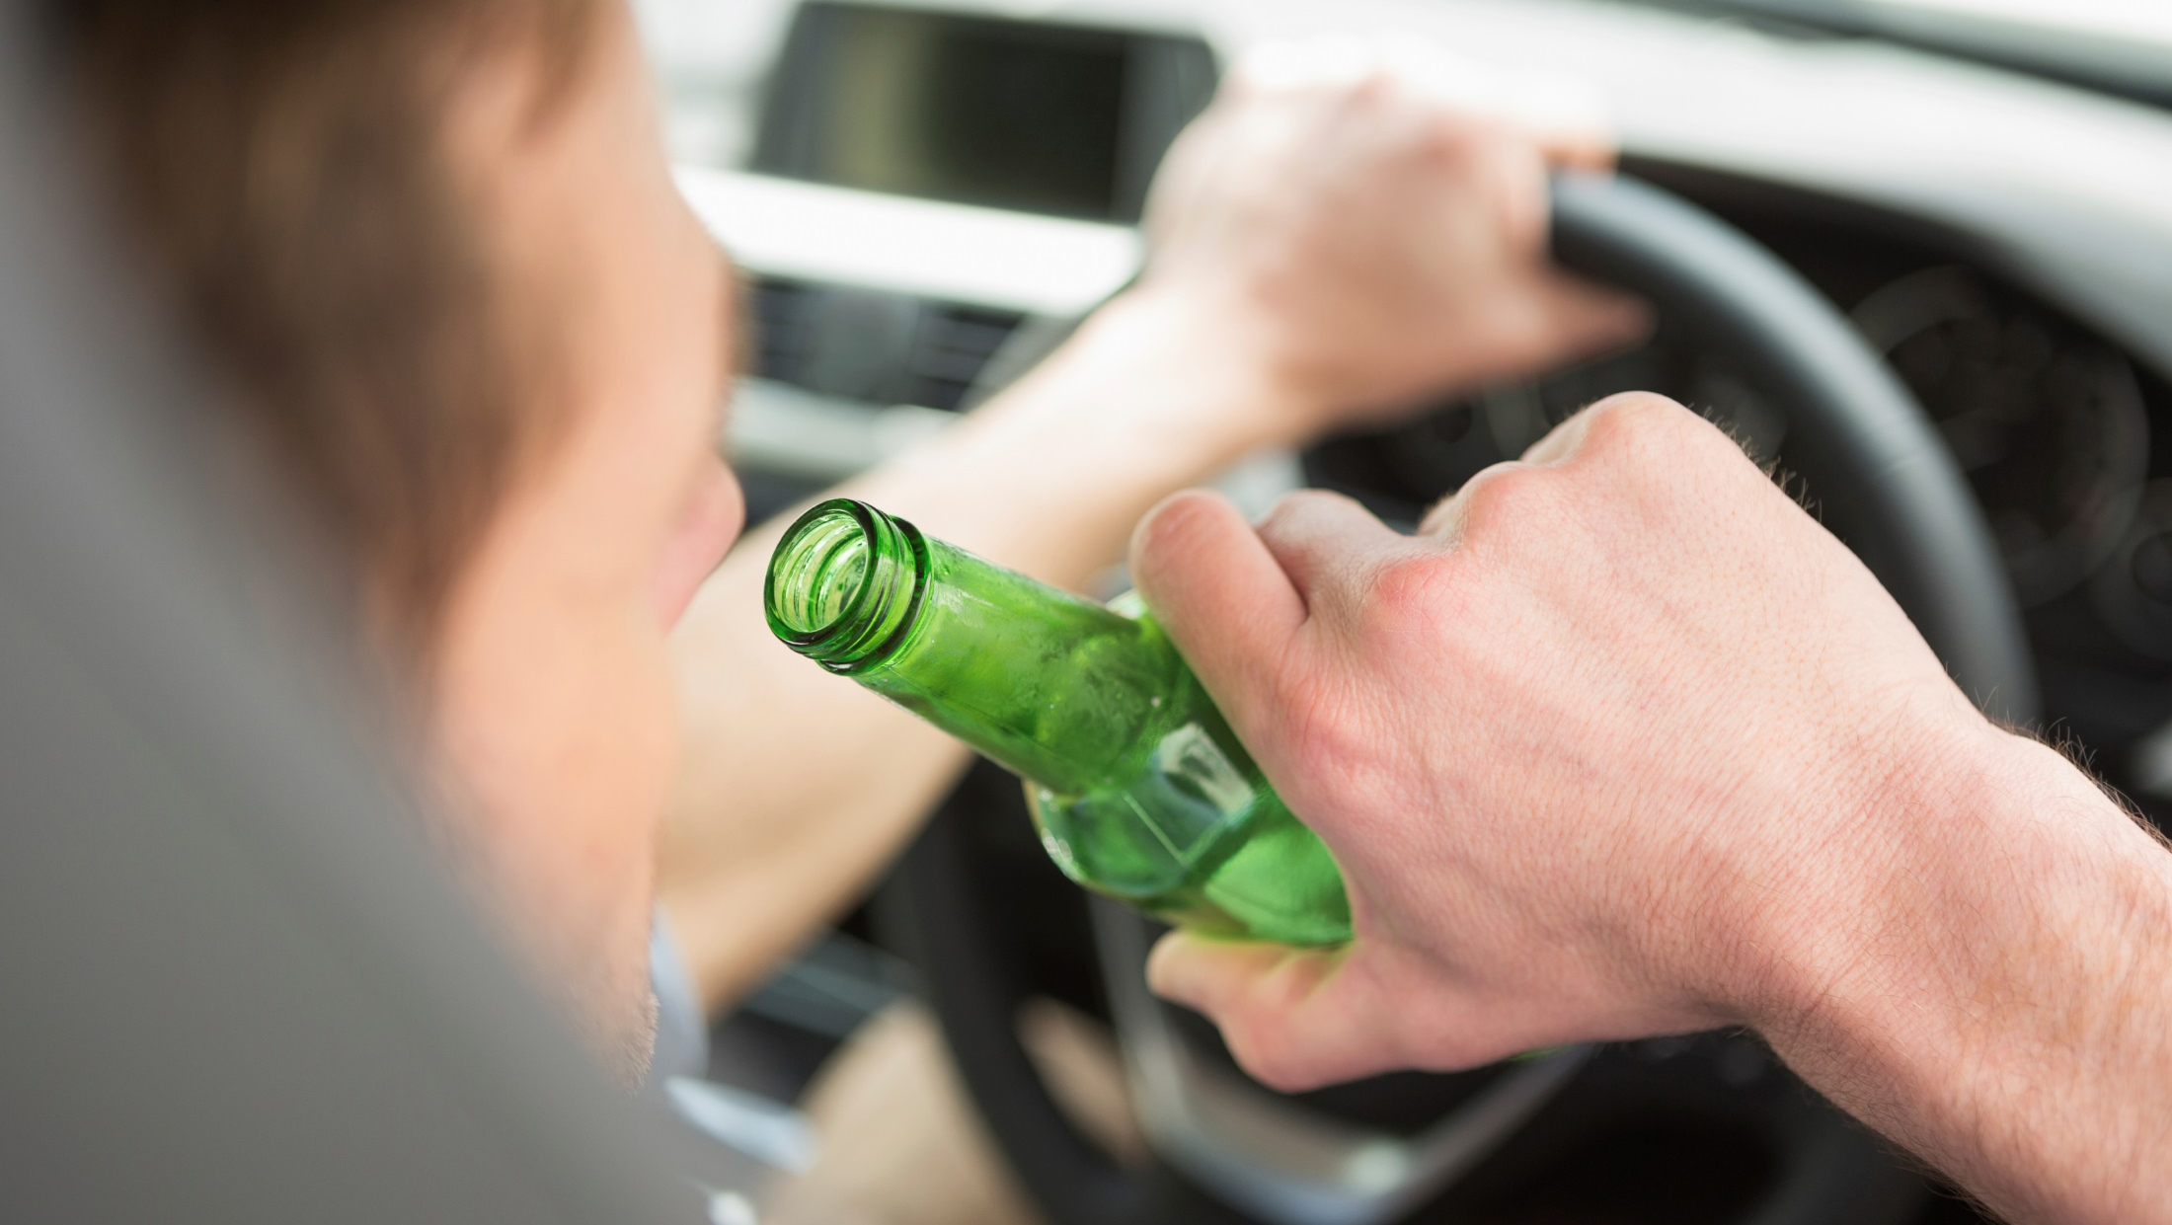
Busted!
Six friends, six open beers
in the car.
Add +$15
GIVE GIRLFRIEND
A RIDE HOME
Notes:
** As if loss of life or disability and insurance rates through the roof are not enough, most states have what’s called Zero-Tolerance.
Two parts:
Under age 21, caught driving with NEGLIGABLE blood alcohol level, immediate arrest for DUI.
Under age 21, caught with ANY alcohol in your system, license automatically suspended or revoked by the DMV.

Slide 54

Good night.
No drama.
No co$t.
HEAD TO AFTER-PARTY WITH THE GUYS

Slide 55

It’s Your CHOICE
Jack’s premium: $100
Jack’s out of pocket costs: $0
Your premium
Your out of pocket costs
Smart driving is about safety
… AND $aving$
Notes:
**Now let’s see how you did.
Presentation Support
Remember when we started, Jack’s premium for the month was $100.
And because he made only SMART driving decisions, what he has to pay this month out of pocket, his deductibles, is $0.
--CLICK
Who wants to share their numbers:
Premium
Deductibles
Interesting / surprising fact learned
--CLICK
The moral of the story:
When you earn the privilege to drive, you need to think about more than safety. You also need to think about SAVINGS.
It’s your choice.

Slide 56

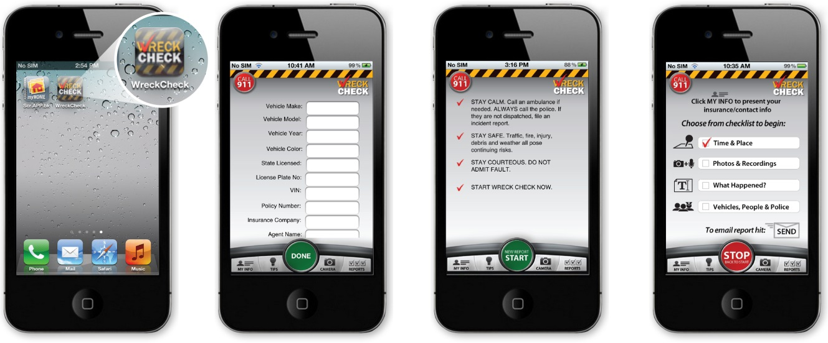

Mobile Application
The WRECKCHECK auto accident checklist and mobile app from the NAIC guides you through the steps to take following an accident.
WRECKCHECK helps you determine what information to share, with whom and what details are important when filing an insurance claim.
56

Slide 57


Extra Credit
Visit www.InsureUonline.org
Read, take a quiz, download:
  WreckCheckApp for Accident Reporting
  Eye-Opening Facts About Teen Drivers
  Teen Driving Contract
Meet Your State Insurance Commissioner
Notes:
**That’s our class. In a moment we’ll take a quiz to see how much you remember.
If you want to get even smarter about insurance, there’s a website, and an app for that.
It’s insureuonline.org. They don’t sell insurance. Information, tools, games and apps to help you educate yourself before something bad happens, and keep you from getting scammed.
And if you need to talk to a real person who knows the rules where you live, that person is your state insurance commissioner. You can find out who that is and how to contact him or her right on the site.
Ask for feedback (best thing/worst thing about the class)
Handout quiz
End

